Slide 1
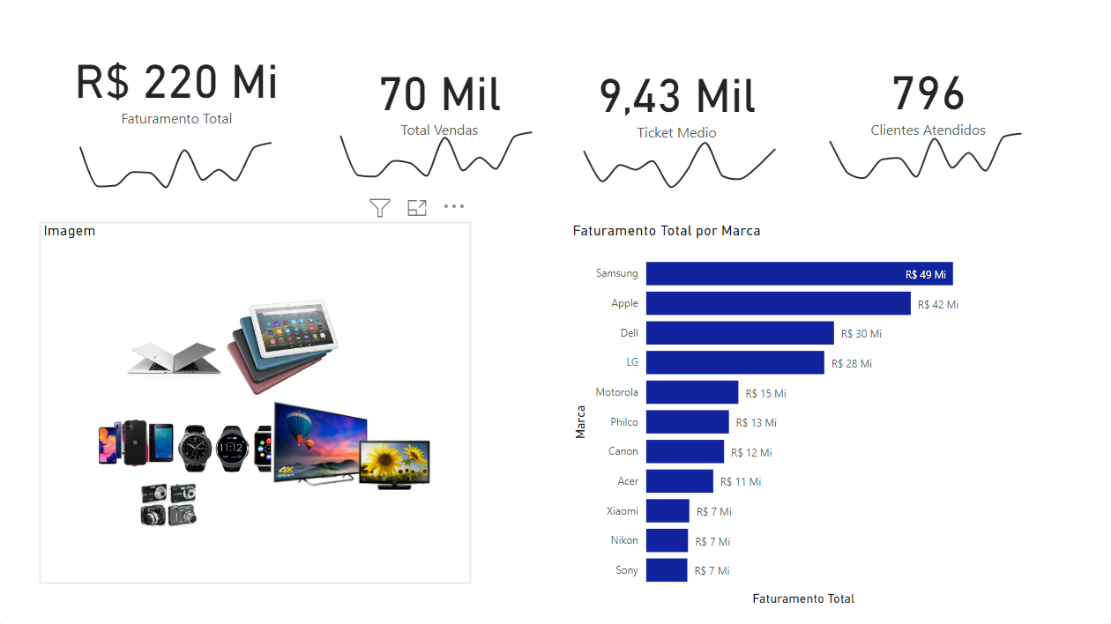
Hashtag Dashboard Logístico

